Slide 1
Perceptron 1957
Neural Networks
Deep Learning
Artificial Intelligence 1950
Machine learning
DeepMind
2010
ImageNet Challenge 2012
Google
2014
TensorFlow 2015
OpenAI
2015 Elon Musk
AlphaGo 2016
AlphaZero 2017
Twitter
2021
Transformer 2018
Microsoft
2019
Bard
2023
chat GPT
2018~
x.AI
2023

Slide 2
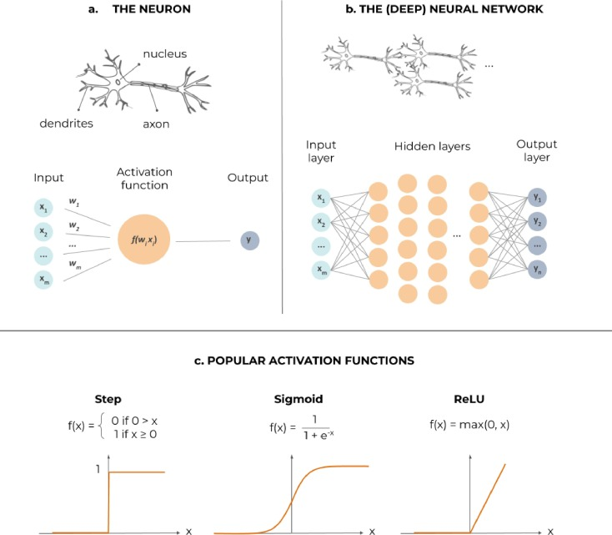

Slide 3
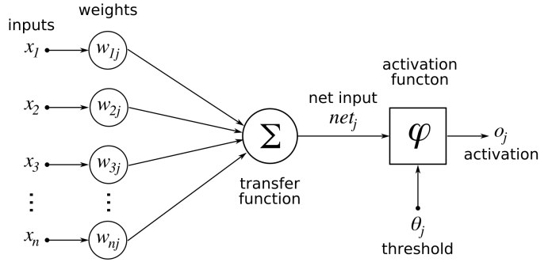
Neural networks

Slide 4
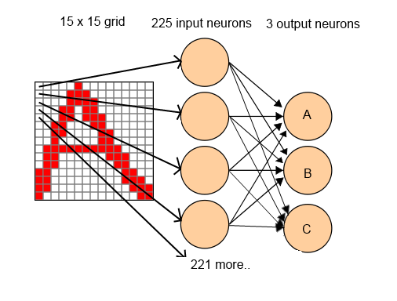
Neural Network Character Recognition

Slide 5
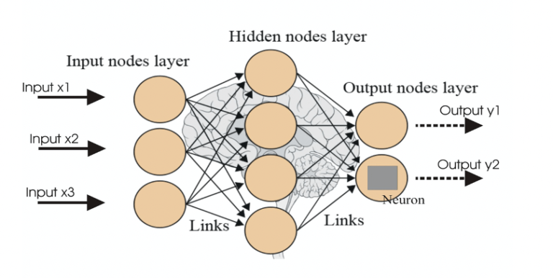
Neural networks

Slide 6
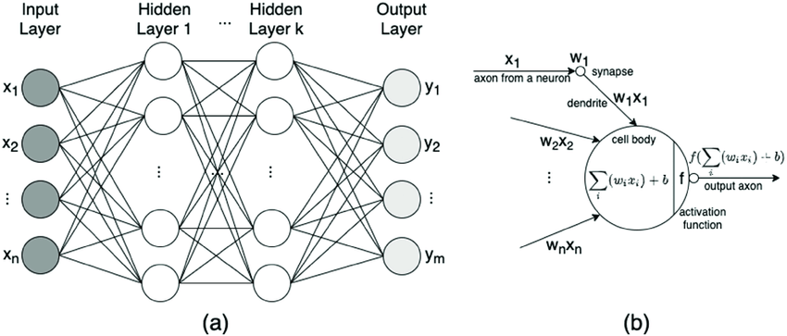
Neural networks

Slide 7
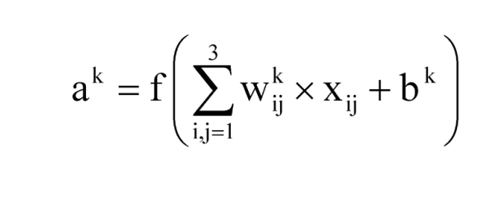
The calculation of the convolutional layer

Slide 8
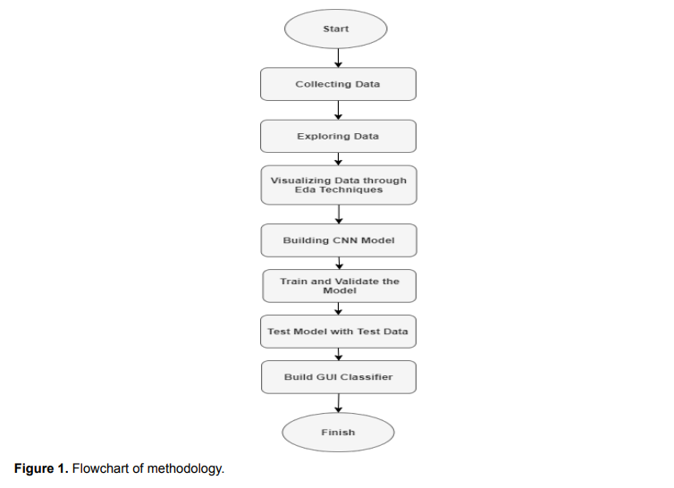
art-7-ed-esp-oct-2020-3c-tecno-2.pdf (3ciencias.com)

Slide 9
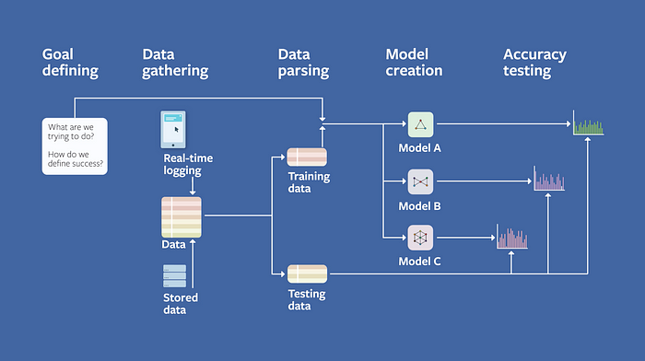
Facebook Field Guide to Machine Learning

Slide 10
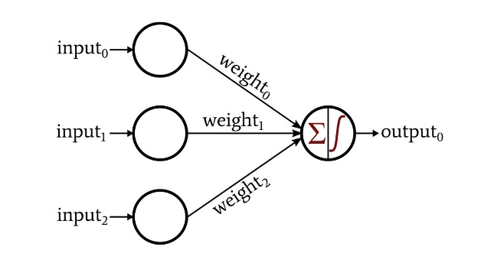
Neural network
Weights: Weights are numerical values assigned to the connections between neurons in different layers of a neural network. Each connection has an associated weight that determines the strength and significance of the signal it carries. During training, these weights are updated through a process called backpropagation, which adjusts them to minimize the difference between the predicted output and the actual output. The weights essentially define the network's ability to capture and represent patterns in the data.
Biases: Biases are additional learnable parameters in a neural network. They act as an offset, allowing the network to adjust the output of each neuron independently. Biases help the network to model more complex relationships in the data by introducing non-linearity. Similar to weights, biases are adjusted during training to improve the network's performance.

Slide 11
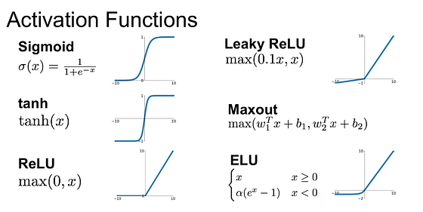
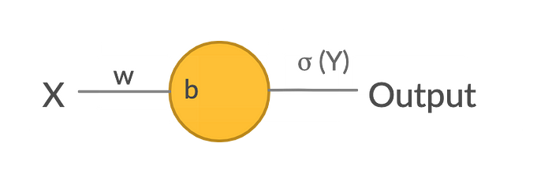
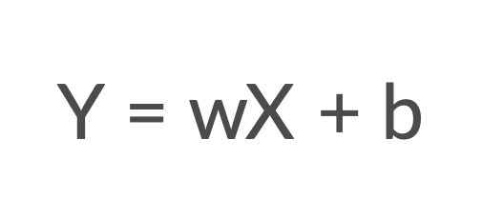

Slide 12
Mathematical logics of neural networks:
명제 논리 (Propositional Logic)
서술 논리 (Predicate Logic)
퍼지 논리 (Fuzzy Logic)
확률 논리 (Probabilistic Logic)
선형 대수 (Linear Algebra)
미적분학 (Calculus)
집합론 (Set Theory)
그래프 이론 (Graph Theory)

Slide 13
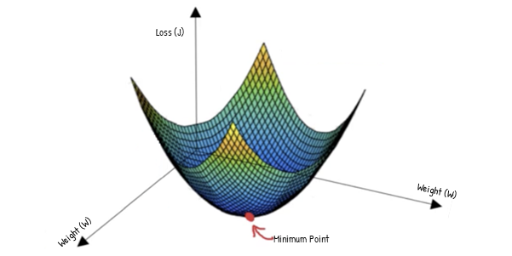
Gradient Descent
Gradient Descent

Slide 14
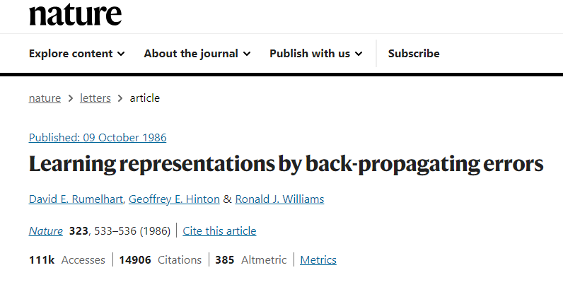
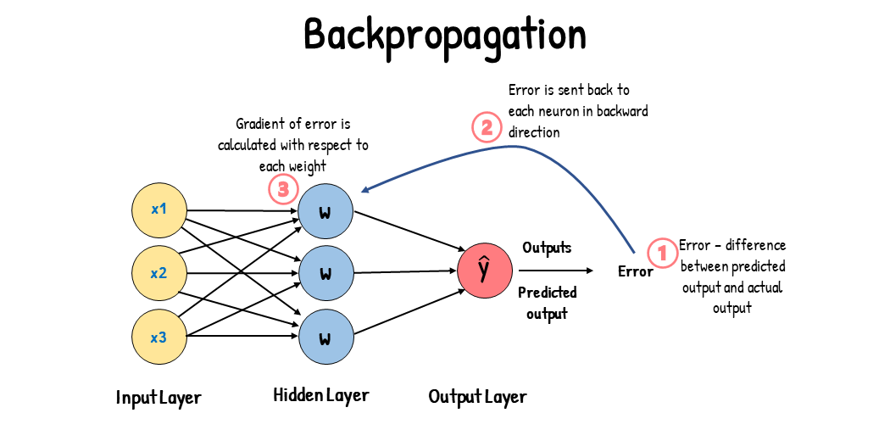
Gradient Descent

Slide 15
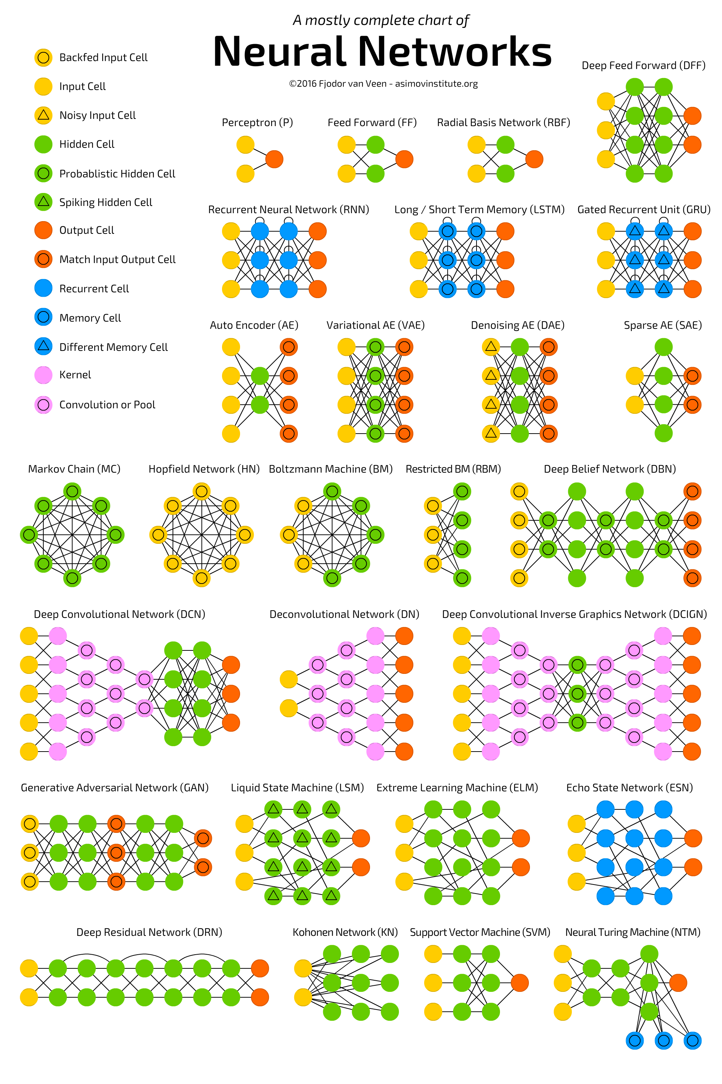

Slide 16
